Slide 1
Interaction models

Slide 2
Intro
Interaction involves at least two participants: the user and the system.
The interface must therefore effectively translate between them to allow the interaction to be successful.
This translation can fail at a number of points and for a number of reasons.
The use of models of interaction can help us to understand exactly what is going on in the interaction and identify the likely root of difficulties.
They also provide us with a framework to compare different interaction styles and to consider interaction problems.

Slide 3
The terms of interaction
The purpose of an interactive system is to aid a user in accomplishing goals from some application domain.
A domain defines an area of expertise and knowledge in some real world activity.
Some examples of domains are graphic design, authoring and process control in a factory.
A domain consists of concepts that highlight its important aspects.
In a graphic design domain, some of the important concepts are geometric shapes, a drawing surface and a drawing utensil.

Slide 4
Tasks are operations to manipulate the concepts of a domain.
A goal is the desired output from a performed task.
For example, one task within the graphic design domain is the construction of a specific geometric shape with particular attributes on the drawing surface.
A related goal would be to produce a solid red triangle centered on the canvas. An intention is a specific action required to meet the goal.

Slide 5
The execution–evaluation cycle
The interactive cycle can be divided into two major phases: execution and evaluation.
These can then be subdivided into further stages, seven in all. The stages in Norman‘s model of interaction are as follows:
1. Establishing the goal.
2. Forming the intention.
3. Specifying the action sequence.
4. Executing the action.
5. Perceiving the system state.
6. Interpreting the system state.
7. Evaluating the system state with respect to the goals and intentions.

Slide 6
It is liable to be imprecise and therefore needs to be translated into the more specific intention, and the actual actions that will reach the goal, before it can be executed by the user.
The user perceives the new state of the system, after execution of the action sequence, and interprets it in terms of his expectations.
If the system state reflects the user‘s goal then the computer has done what he wanted and the interaction has been successful; otherwise the user must formulate a new goal and repeat the cycle.

Slide 7
Norman uses this model of interaction to demonstrate why some interfaces cause problems to their users.
He describes these in terms of the gulfs of execution and the gulfs of evaluation.
As we noted earlier, the user and the system do not use the same terms to describe the domain and goals – remember that we called the language of the system the core language and the language of the user the task language.
The gulf of execution is the difference between the user‘s formulation of the actions to reach the goal and the actions allowed by the system.

Slide 8
If the actions allowed by the system correspond to those intended by the user, the interaction will be effective.
The interface should therefore aim to reduce this gulf. The gulf of evaluation is the distance between the physical presentation of the system state and the expectation of the user.
If the user can readily evaluate the presentation in terms of his goal,the gulf of evaluation is small.
The more effort that is required on the part of the user to interpret the presentation, the less effective the interaction.

Slide 9
The interaction framework
The interaction framework attempts a more realistic description of interaction by including the system explicitly, and breaks it into four main components.
The nodes represent the four major components in an interactive system – the System, the User, the Input and the Output.
Each component has its own language. In addition to the User‘s task language and the System‘s core language, which we have already introduced, there are languages for both the Input and Output components.
Input and Output together form the Interface.

Slide 10
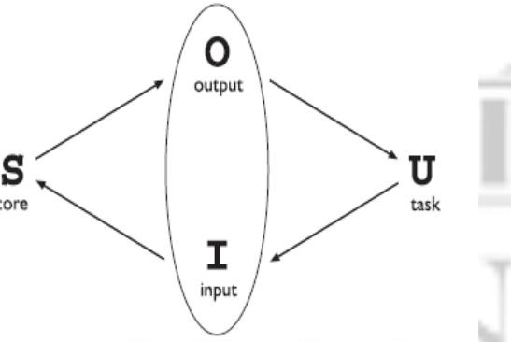
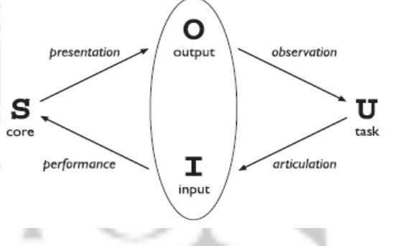
The general interaction framework
Translations between components

Slide 11
The System then transforms itself as described by the operations; the execution phase of the cycle is complete and the evaluation phase now begins.
The System is in a new state, which must now be communicated to the User.
The current values of system attributes are rendered as concepts or features of the Output.
It is then up to the User to observe the Output and assess the results of the interaction relative to the original goal, ending the evaluation phase and, hence, the interactive cycle.
There are four main translations involved in the interaction: articulation, performance, presentation and observation.

Slide 12
Assessing overall interaction
The interaction framework is presented as a means to judge the overall usability of an entire interactive system.
This is not surprising since it is only in attempting to perform a particular task within some domain that we are able to determine if the tools we use are adequate.
For a particular editing task, one can choose the text editor best suited for interaction relative to the task.
The best editor, if we are forced to choose only one, is the one that best suits the tasks most frequently performed.
Therefore, it is not too disappointing that we cannot extend the interaction analysis beyond the scope of a particular task.

